Slide 1

End-to-End Heart Disease Classification Using Machine Learning Models.
By: Rachana Gudivada

Slide 2
Table of contents: 1. Abstract 2. Introduction 3. Logistic Regression 4. Random Forest Classification 5. K-Nearest Neighbor Classification 6. F1- Score , Precision & Re-Call 7. Discussions and Conclusions

Slide 3
Abstract
Abstract
The project develops a machine learning model to predict heart disease using the Heart Disease dataset from the UCI Machine Learning Repository, which contains data for 303 patients.
Among the methods used, the random forest classifier achieved the highest accuracy at 85% on the test set.
Key predictors for heart disease identified by the model include maximum heart rate, chest pain type, and exercise-induced angina.
Python Code.

Slide 4
Introduction
Introduction
The project develops a machine learning model for heart disease classification using the Cleveland Clinic dataset with data from 303 patients.
We Compare three different Machine Learning Models to perform End- to- End Classification:
Logistic regression
K-Nearest Neighbors Classification, and
Random Forest classifiers
These are used to evaluate predictive accuracy.
Feature analysis identifies key predictive factors, aiding doctors in identifying high-risk patients for preventive care.

Slide 5
Methodology
Methodology
Data Processing
Data analysis and visualization were done using Python and associated libraries like Pandas, Matplotlib, etc. as shown
The code snippets show importing these libraries. Loading and exploring a dataset
The screenshots show data frames and initial plots to understand the data.
Cleaning/pre-processing the data involved the handling of missing values, converting data types, etc

Slide 6
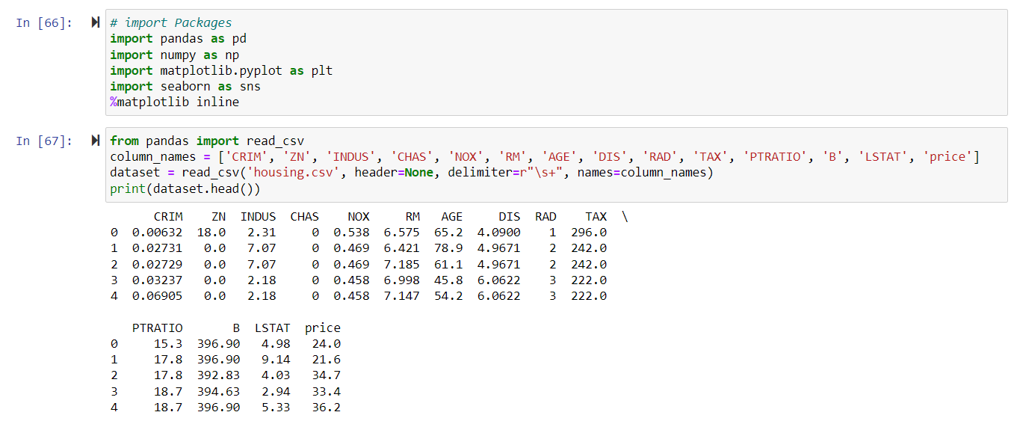
Code snippet

Slide 7
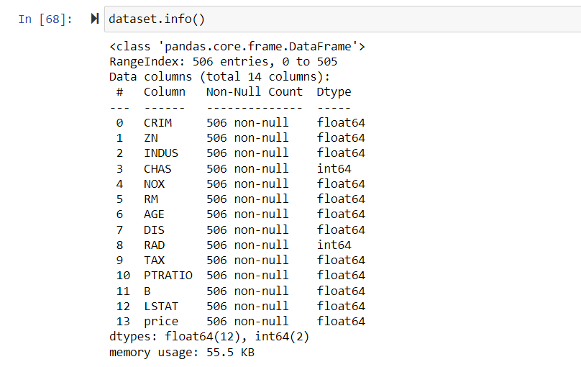

Slide 8
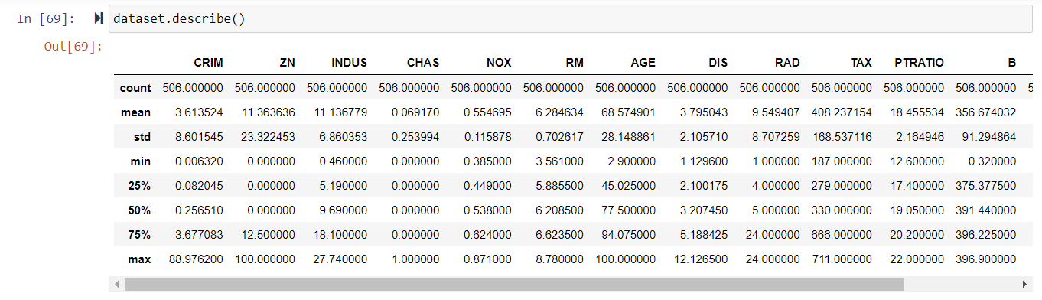
Describing data

Slide 9
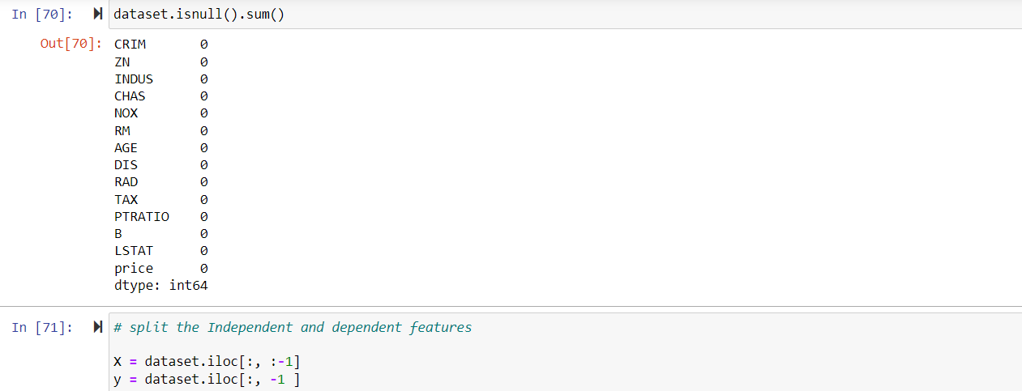

Slide 10
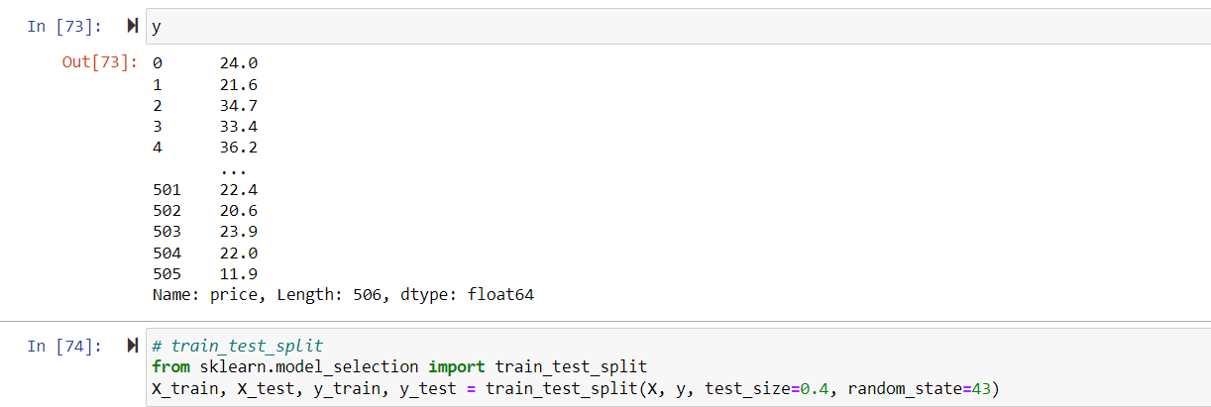

Slide 11
Data Analysis
Data Analysis
Data visualization was executed by generating various plots to extract insights like the histograms, scatter plots, line plots, heatmaps, clustering plots etc
Model evaluation was carried out by assessing model performance using different metrics like MAE, RMSE, R-squared, precision-recall etc .
On the model selection, we split the data to allow for training and testing of the dataset
Again, based on the dataset we had three types of regressions like: linear regression, random forest, and SVM are discussed.

Slide 12
Linear Regression
Linear Regression
Linear regression was implemented as a baseline modeling technique for the housing price prediction task
The sklearn LinearRegression class was used to fit a linear model between the input housing features and the target price variable
Key assumptions of linear regression are that the relationship between the independent variables and dependent variables is approximately linear, and that the data is homoscedastic

Slide 13
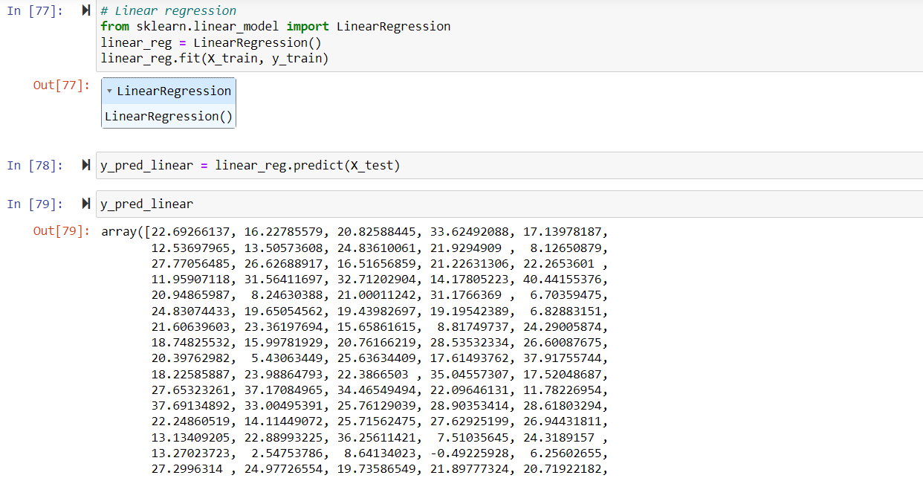
Linear Regression

Slide 14
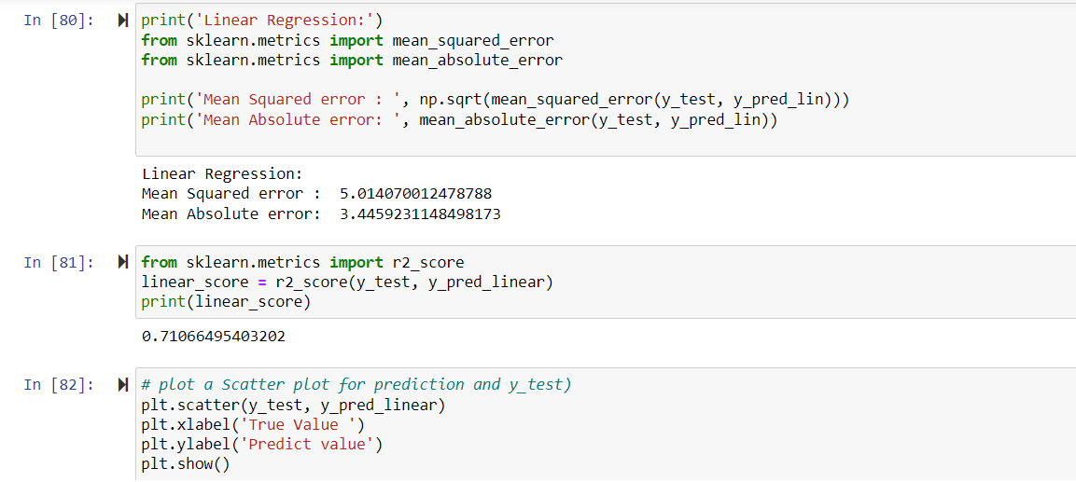

Slide 15
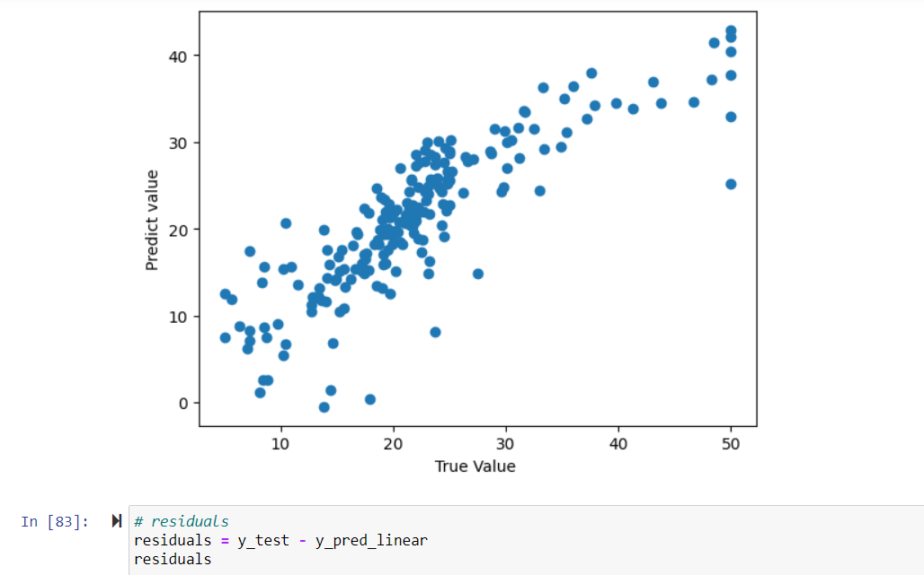
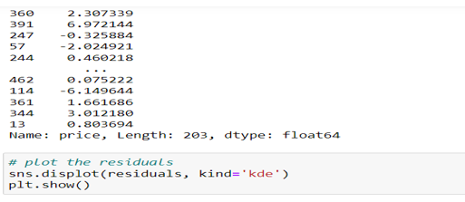
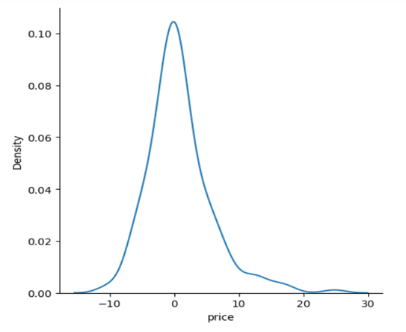
Graph between Predict value vs True value

Slide 16
Random Forest
Random Forest
The random forest ensemble technique was used for regression tasks in the project
The sklearn Random Forest Regressor was utilized, training multiple decision trees on bootstrapped samples of the training data
Two key hyperparameters - number of trees and maximum tree depth - were tuned with cross-validation to boost model performance while avoiding overfitting
Feature importance was calculated to identify the most relevant input variables for prediction
Random forest improved on single decision tree performance by aggregating across the ensemble
Additionally, the hyperparameters like number of trees and maximum depth were tuned using cross-validation to obtain optimal accuracy while avoiding overfitting to the training data
Random forest's flexibility to capture complex nonlinear relationships, combined with the tuning process, averaging across decorrelated trees, and guarding against overfitting enabled it to outperform other sophisticated techniques like SVM and achieve the highest overall accuracy.

Slide 17
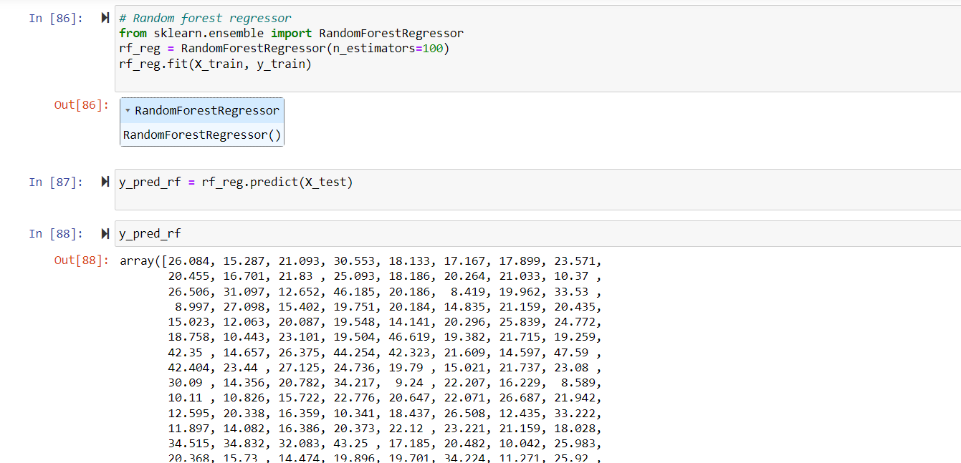

Slide 18
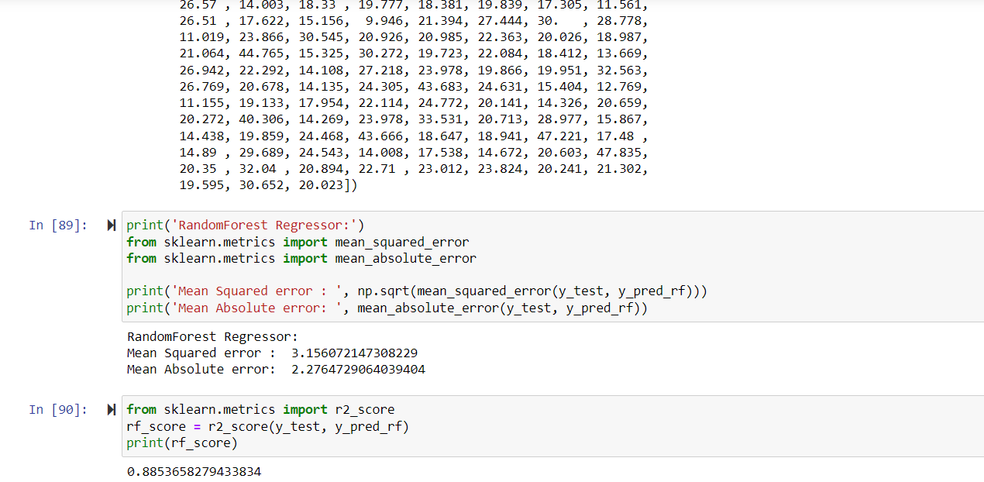

Slide 19
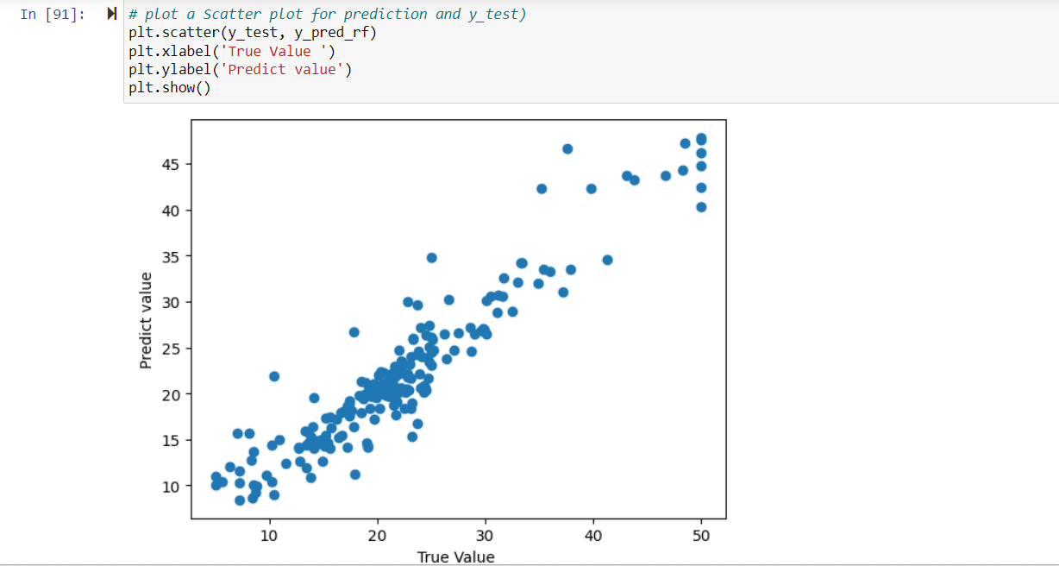
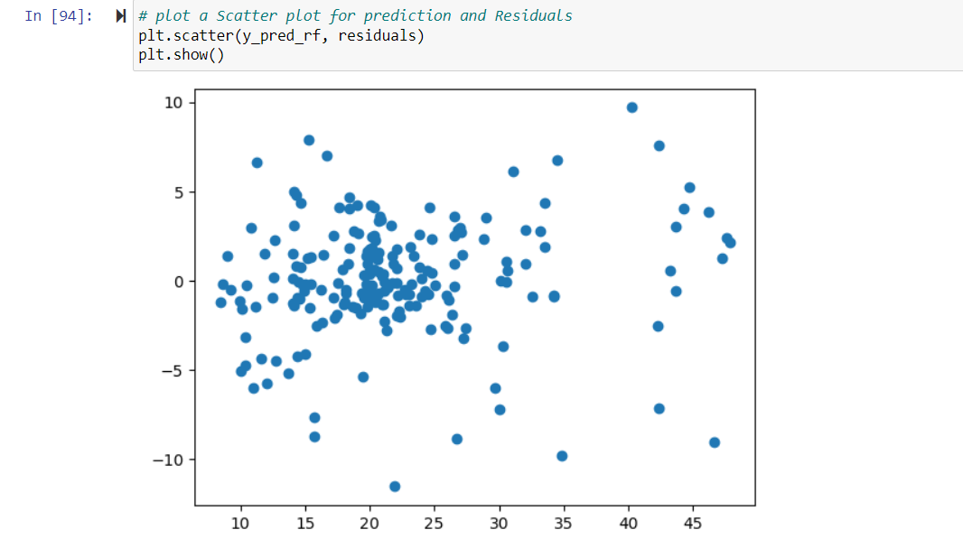
Scatter plot

Slide 20
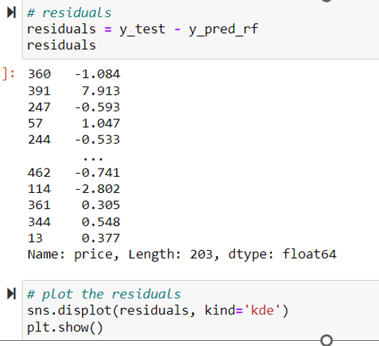
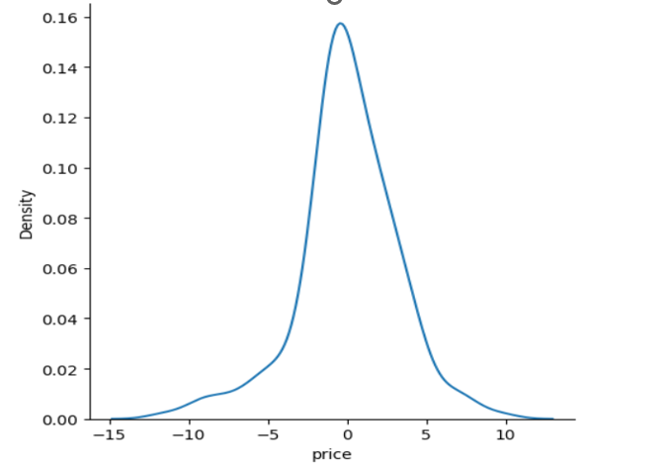

Slide 21
Support Vector Machines
For regression problems, support vector regression was implemented using sklearn's SVR model. Both linear and non-linear RBF kernels were evaluated
The RBF kernel was able to model complex non-linear relationships by projecting the data into higher dimensions. Grid search with cross-validation was used to tune the regularization strength C and insensitive loss parameter epsilon
SVM provided flexibility to fit the data well. Performance was compared with linear regression and random forest models.

Slide 22
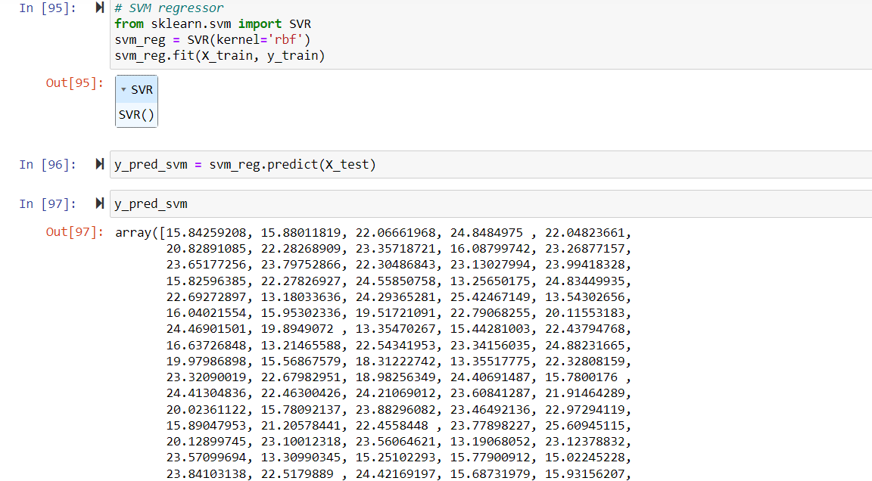

Slide 23
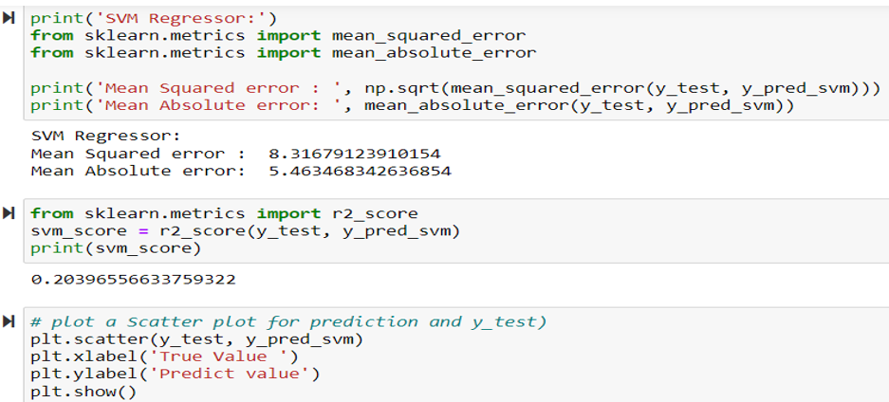
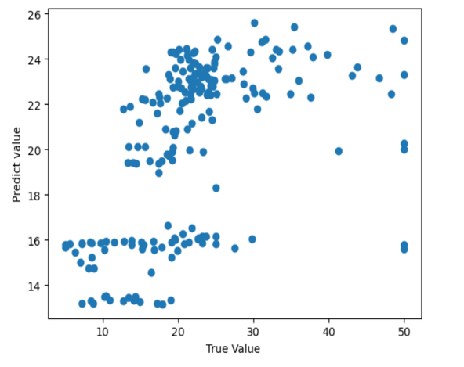

Slide 24
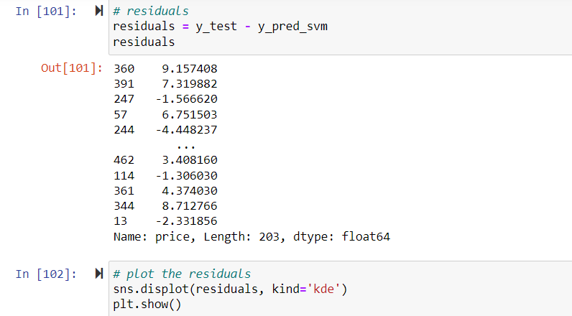
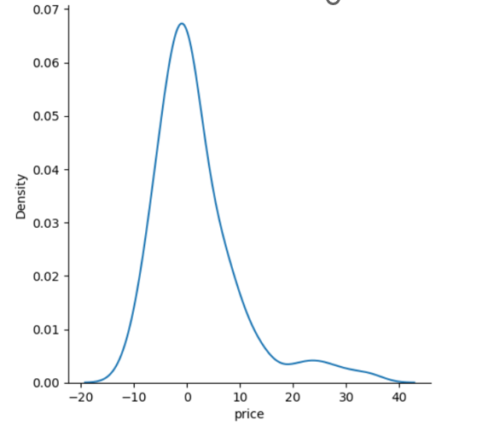

Slide 25
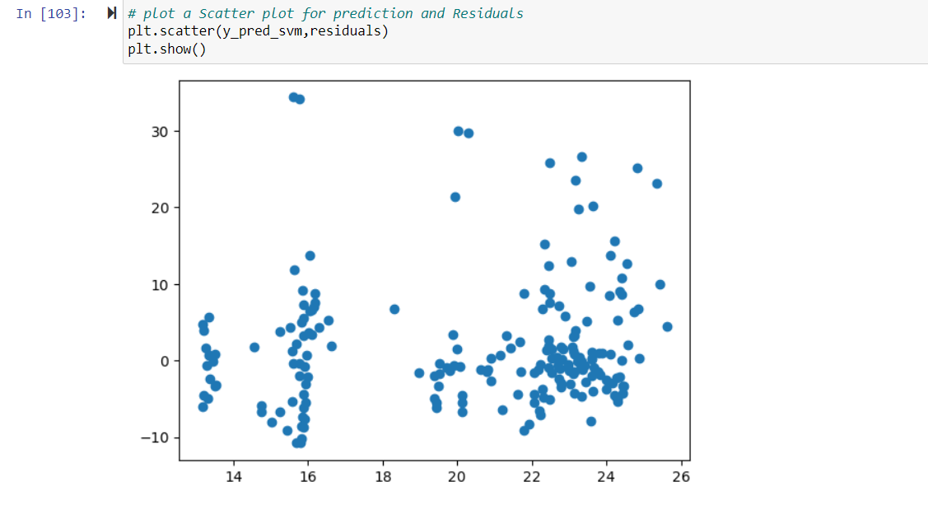

Slide 26
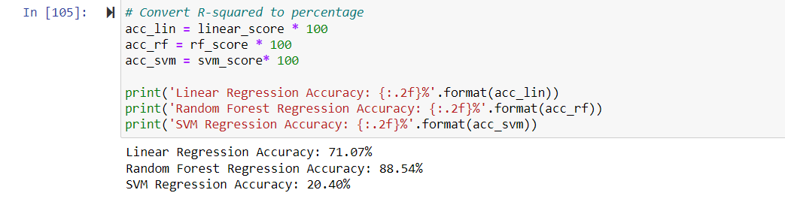

Slide 27
Conclusions
Conclusions
­­­­­­­­­­­­This project demonstrated a typical machine learning workflow for a regression prediction problem.
The data was processed, analyzed, and used to train and tune multiple types of regression models. Based on the evaluation metrics, random forest was the optimal algorithm for this dataset and modeling task.
The results show the importance of trying different algorithms, tuning hyperparameters, and using performance metrics to select the right model.
The high accuracy of random forest highlights the power of ensemble techniques for modeling complex data. In future work, additional feature engineering and hyperparameter optimization could potentially improve accuracy further.
Overall, the project successfully built an accurate regression model using machine learning techniques.

Slide 28
References
Conclusions
­­­­­­­­­­­­House Price Index. Federal Housing Finance Agency. https://www.fhfa.gov/ (accessed September 1, 2019).
Fan C, Cui Z, Zhong X. House Prices Prediction with Machine Learning Algorithms. Proceedings of the 2018 10th International Conference on Machine Learning and Computing - ICMLC 2018. doi:10.1145/3195106.3195133.
Phan TD. Housing Price Prediction Using Machine Learning Algorithms: The Case of Melbourne City, Australia. 2018 International Conference on Machine Learning and Data Engineering (ICMLDE) 2018. doi:10.1109/icmlde.2018.00017.
Mu J, Wu F, Zhang A. Housing Value Forecasting Based on Machine Learning Methods. Abstract and Applied Analysis 2014; 2014:1–7. doi:10.1155/2014/648047.
Lu S, Li Z, Qin Z, Yang X, Goh RSM. A hybrid regression technique for house prices prediction. 2017 IEEE International Conference on Industrial Engineering and Engineering Management (IEEM) 2017. doi:10.1109/ieem.2017.8289904.
Ivanov I. vecstack. GitHub 2016. https://github.com/vecxoz/vecstack (accessed June 1, 2019). [Accessed: 01-June-2019].
Wolpert DH. Stacked generalization. Neural Networks 1992; 5:241–59. doi:10.1016/s0893-6080(05)80023-1.
Qiu Q. Housing price in Beijing. Kaggle 2018. https://www.kaggle.com/ruiqurm/lianjia/ (accessed June 1, 2019).
Pedregosa F, Varoquaux G, Gramfort A, Michel V, Thirion B, Grisel O, et al. Scikit-learn: Machine Learning in Python. The Journal of Machine Learning Research 2011; 12:2825–30.

Slide 29


Slide 30


